Slide 1
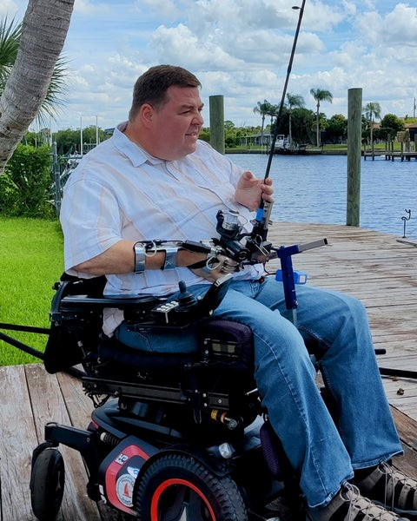
ADAPTED FISHING
Lets gear up to roll along exploring the red shores, sandy beaches and the many watersheds P.E.I has to offer when looking for the best fishin’ hole!.

Slide 2
What is adaptive fishing?
Adaptive fishing is a type of fishing that is designed to be accessible and inclusive for individuals with disabilities. Adaptive fishing involves the use of specialized equipment and techniques to allow people with disabilities to participate in the sport. This may include the use of adaptive fishing rods, reels, and other equipment to accommodate individuals with physical or cognitive impairments.
Adaptive fishing may also involve modifications to fishing locations or the use of specialized boats or other equipment to make the sport accessible to individuals with disabilities. The goal of adaptive fishing is to make the sport of fishing accessible and enjoyable for people of all abilities.

Slide 3
With the help of adaptive fishing equipment and organizations, adaptive fishing is available to people of all abilities. If you are fishing from a boat, it is important to wear a life jacket and have personal flotation devices for all on board. For those with limited mobility, pontoon boats or public access piers may be suitable options. Remember to bring safety equipment such as safety glasses, insect repellent, sunscreen, a flashlight, and a cell phone, and let someone know your whereabouts. Whether you go fishing alone or with friends and family, adaptive fishing can be a relaxing and enjoyable activity.

Slide 4
What types of adaptive fishing equipment is out there?
Adaptive fishing equipment makes it possible for individuals with disabilities to enjoy the sport. There are various types of equipment adaptations available, including fishing rod mounts, harnesses, and holders, electric fishing reels, and knot tyers. Fishing rod mounts can fasten to a boat or wheelchair, strap to the user's chest or forearm, or be sat upon to hold the rod for those with limited or no use of their hands. The clamp on fishing pole holder provides a secure grip on the pole while also making the reel accessible for one-handed operation. By using adaptive fishing equipment, individuals with disabilities can participate in the sport and experience the beauty of the great outdoors and the thrill of the catch.

Slide 5
Fishing rod mounts: These are devices that allow individuals with disabilities to hold a fishing rod steady while casting and reeling in. Rod mounts can be attached to a boat, wheelchair, or other surface, or they can be worn on the chest or forearm. Electric reels: These are specialized reels that can be operated with the touch of a button, making them accessible for individuals with limited hand function. Electric reels typically have power units with batteries that last for several hours. Knot tyers: These are devices that can thread hooks, tie knots, and cut lines, making them helpful for individuals with limited hand function. Knot tyers can be handheld or mounted on a surface. Reel adapters: These are devices that can be attached to a standard reel to make it easier for individuals with disabilities to operate. Reel adapters may include handle extensions, lever handles, or other modifications to the standard reel. Wheelchair ramps: These are ramps that can be used to access fishing locations that may not be easily accessible for individuals using wheelchairs. Wheelchair ramps may be portable or permanent. Stabilizing chairs: These are specialized chairs that can be used to help individuals with disabilities maintain a stable position while fishing. Stabilizing chairs may have additional supports or features to help with balance and stability. Fishing rod holders: These are devices that can be attached to a boat, wheelchair, or other surface to hold a fishing rod steady while the user is casting and reeling in. Fishing rod holders can be adjustable to accommodate different rod sizes and styles.

Slide 6
Fishing Palm Cuff & Reel Deal The palm cuff fits over two fingers (which ever two fingers feel best for you). The cuff is secured around your wrist with a Velcro strap. There is Velcro on the palm of the cuff. You will press hand with the cuff on it against the Velcro portion of the Reel Deal to begin reeling. The cuff is used in conjunction with our Reel Deal. $15 + $60
Freedom Fisher Power Assist Reel The FreedomFISHR™ replaces a manual crank with a powerful 12V gear motor – making one-handed fishing, effortless! Advanced circuitry along with Lithium-Ion Polymer battery technology bring this system to life with more efficiently than ever before. The FreedomFISHR™ was engineered for weight reduction and value WITHOUT ever compromising power and capability. The end result is a superior product with less fatigue, better sensitivity and bringing more FUN to your fishing experience! $150

Slide 7
Limited Mobility Fishing Mount $550 - $900 US The Model FM200 is a limited mobility fishing mount built on our standard seat pan. It is designed to be used by anyone that does not have the ability to hold the rod. The rod can be manually cast and then placed into the mount by either the user or a fishing buddy. The mount allows the user to pull back to set the hook and has resistance in the forward motion to keep the fish on the line. The mount also has two handles which can be positioned in eight different spots on either side of the mount for maximum comfort. It allows the user to be able to adjust it for right or left hand use. One handle is a forearm roller to allow the user to lay their arm on the roller and push the arm forward and back making it much easier to operate the reel. The mount will swivel left and right and the tension is easily adjusted to match the user’s ability.

Slide 8
Rock Island Power Fishn’ Pro $200US The Rock Island PowerFish’n Pro is a hybrid reel for fresh water fishing. The PowerFish’n Pro features a Shakespeare spinning reel fitted with a strong, quiet, electric motor to enhance the fishing experience. It gives users the ability to manually hand crank the line in as well as retrieve it automatically with the touch of a switch. Users can fish longer without fatigue, have more options and techniques for catching fish and generally enjoy fishing even more.
Fish Winch Electric Spinning Reel $360 - $1000+ FISH WINCH® 4000 adaptive fishing reel drives for spinning reels along with the Shimano Quick Fire II system allow for true one-handed casting & retrieving. FISH WINCH® 4000 electric spinning reel drives are cordless, easy to use, weigh only 10oz (including 9V lithium battery), and are available in 2 retrieve speeds. FISH WINCH® 4000 can be used for most freshwater and light (inshore) saltwater fishing. Our adaptive fishing reel is designed for those with use of only one hand or arm and those that may be physically challenged, disabled, or handicapped in some way.

Slide 9
Adapted equipment suppliers
Be adapted: Brian Kyler metal fabricator, had a dream of making a better shooting device. He and his two sons now make adapted shooting and fishing gear.
https://beadaptive.com/product-category/fishing/?gad_source=1&gclid=Cj0KCQjwv7O0BhDwARIsAC0sjWPIDRhJhrXFzVXcqXtN-pRvAO5qO10SII9h297EMJWhcxxNgNrvdm4aAkLgEALw_wcB
Handi accessories: Talbot Kennedy had his accident at 18 and wanted efficient ways to go about his day.
https://handiaccessories.com/

Slide 10
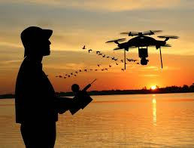
Fishing with tech
Fish and Depth finders
Includes:
From the shore sensing.
Fly over drones.
Remote Control boats.
Electric lures/bait/ flies.
Remote guided casting devices.
even goes as far as lure attached underwater cameras.

Slide 11
Ready to go? Don't forget your license!
To fish legally in most areas, you will need to obtain a fishing permit or license. These permits are typically issued by state or provincial governments and are valid for a certain period of time. To get a fishing permit, you may need to provide proof of residence, pay a fee, and complete a short course on fishing regulations. In some cases, you may also need to provide your social security number or other identifying information. You can usually purchase a fishing permit online, by phone, or in person at a local department of natural resources office or sporting goods store. Some areas may have different rules and regulations for fishing, so it is important to check the specific requirements in your area before you begin fishing.

Slide 12
When does angling season open and close? Angling season for all freshwater fish species opens on April 15th of each year (in most locations). Open and closing dates may vary depending on location and species. Please refer to the 2024 Angling Summary for details. Do I need a licence to fish on PEI? Angling Licences are required by everyone 16 years of age and older​; Children under 16 years of age do not require an angling licence; Resident and Non-Resident Angling Licences are available for $10/year plus HST; Courtesy Angling Licences are issued free-of-charge to those 16 to 18 and 60 years of age and older; Family Five-Day Fishing Licences are available for $5 plus HST;. This licence allows you, your spouse and dependants to fish for a period of five consecutive days and is available after May 1st each year; and NEW! Courtesy Angling Licenses are issued to active Canadian Forces members and Canadian Forces veterans. Pei does not offer discounts to disabled residents. N.S Does offer this feature.
2024_angling_summary.pdf
angling_vendors_2024_-_updated_15apr2024.pdf
w04-1-1-wildlife_conservation_act_angling_regulations.pdf

Slide 13
Are there any other fees? Yes. All licensed anglers are also required to have and possess a valid Wildlife Conservation Fund(link is external) Licence (WCF). The WCF fee can be applied to Hunting and Trapping licences with the licence year. Anglers from ages 16 to 64 must pay the Wildlife Conservation Fund fee of $20/yr plus HST;. For Seniors 65 years of age and over, the Wildlife Conservation Fund is $13/yr plus HST; For the Family Five-day Fishing License, the Wildlife Conservation Fund fee is $5 plus HST; Youth under the age of 16 are exempt from the WCF fee NEW! Active Canadian Forces members and Canadian Forces veterans are exempt from the WCF fee. Link to buy license https://www.princeedwardisland.ca/en/service/online-fishing-licences

Slide 14
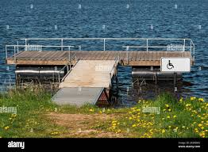
What's new for the 2024 angling season? Complimentary Angling Licenses will now be provided to Canadian Armed Forces members and veterans. Please note: all licensed anglers are required to be in possession of a Wildlife Conservation Fund License. The Morell River Trout Tagging Study will continue in 2024 (April). Are there any special angling events or activities? Each year, the May long weekend marks Free Family Fishing weekend on PEI. In 2024, Free Family Fishing weekend runs from May 17 to Monday May 20, inclusive. Angling licenses are not required but anglers must abide by all regulations and rules. General Inquiries Forests, Fish and Wildlife Division J. Frank Gaudet Tree Nursery 183 Upton Road Box 2000 Charlottetown, PE C1A 7N8 Phone: 902-368-6450 Wildlife Emergencies: 902-368-4683

Slide 15
Some of the benefits of adaptive fishing include: Physical activity: Fishing can be a physically active activity, as it requires some level of movement and dexterity to cast, reel in, and handle the fish. This can help improve physical fitness and coordination. Mental health: Fishing can be a relaxing and meditative activity, as it allows people to spend time in nature and focus on a single task. This can help reduce stress and improve mental health. Social interaction: Fishing can be a social activity, as it allows people to connect with others who have a shared interest in the sport. This can help improve social skills and build relationships. Accessibility: Adaptive fishing equipment makes it possible for individuals with disabilities to participate in the sport and enjoy the benefits of fishing. Therapeutic value: For some individuals with disabilities, adaptive fishing can provide a sense of accomplishment and a feeling of independence. It can also help improve self-esteem and overall well-being.

Slide 16
The Health Benefits of Fishing: Why You Should Give It a Try
Cast your line into the world of recreational fun, and you'll find fishing reigning as a global favorite! It's a breeze to pick up, a blast to partake in, and an adventure that pushes you to sharpen your skills. Fishing isn't just about landing the big one—it's a fountain of physical and mental well-being for anglers of every stripe. So what's the scoop on how fishing leads to happier, healthier lives? Reel in now for an amazing treat as we discuss the health benefits of recreational fishing.

Slide 17
You might see fishing as a pastime, a relaxation technique, or simply a means to catch dinner. Yet, did you realize just how profoundly beneficial it is for your health? From boosting your physical fitness to enhancing your mental well-being, the array of health advantages fishing offers is so vast and diverse that it's hard to fully grasp its magnitude.

Slide 18
Physical Benefits of Fishing Fishing comes in countless styles, just like the variety of fish in the sea. Yet, they share some basic elements: being outdoors, catching fish, and perhaps bringing some home to eat. It might seem simple, but it can seriously boost your health. Let's break it down. It lets you exercise. Keeping fit is no walk in the park. It can be Wheelie hard to get motivated. While it might not initially strike you as a hardcore workout, that's precisely its charm. It's a form of low-impact cardio that adapts to your pace, whether you're seeking a leisurely outing or a vigorous challenge. The beauty lies in its versatility—you can kickstart your fitness journey from scratch without the need for intimidating gym equipment. Simply head to your local fishing spot, cast your line, and reel in a catch. Once you've mastered the basics, you can ramp up the intensity with techniques like jigging or fly fishing. It lets your lungs breathe in fresh air. Air pollution wreaks havoc on your health, leading to a range of issues from respiratory issues to heart disease. Spending time outdoors exposes you to clean, oxygen-rich air, which can work wonders for your lungs. Add a bit of physical activity to get your heart pumping, and you'll find yourself breathing easier than ever before. Being near water holds even more benefits. Flowing water generates negative ions, minuscule charged particles known to bolster the immune system, rev up metabolism, and regulate sleep patterns. Plus, they're fantastic mood boosters. Granted, we're not suggesting that a brief fishing trip will solve all your problems. However, regular doses of fresh air can certainly aid your breathing and offer your body a chance to rejuvenate. Lets not forget you have a nutritious meal. If you catch anything worth eating.

Slide 19
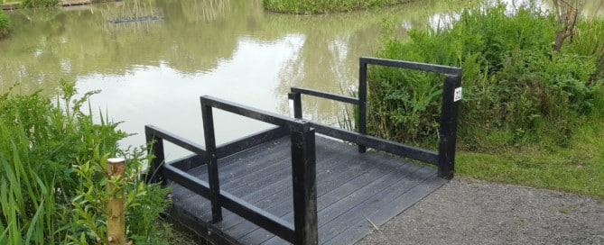
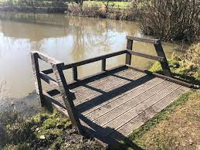
SUNLIGHT Few sensations rival the warmth of the morning sun on your face, delivering a much-needed dose of vitamin D that's bound to brighten your day. Beyond its mood-boosting properties, vitamin D plays a crucial role in fortifying your immune system, expediting healing, and facilitating proper calcium absorption—essential for maintaining robust bones and teeth. But here's the kicker: despite our familiarity with vitamin D and its sources, many of us fall short on outdoor time, a trend that predates even the events of 2020. On average, Americans spend a mere 7.6% of their day outdoors while people in the UK clock in at just 2.6%—equivalent to slightly over half an hour! conditions like rickets have witnessed a significant resurgence over the past two decades. So what's the solution? Head to the water and indulge in some fishing. Engaging in this activity allows you to bask in extended periods of open space, soaking in those vital rays.

Slide 20
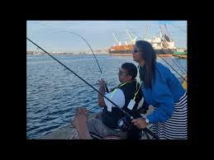
Mental Benefits of Fishing Fishing is a game-changer for mental well-being, too. A few hours of angling can make a world of difference. Let's explore why. It can relieve stress and anxiety. Fishing brings together several powerful elements. Firstly, you're immersed in nature, proven to significantly impact mental well-being. Plus, being near water generates mood-enhancing negative ions and fosters a naturally meditative state of mind. But it doesn't stop there. The act of fishing itself offers its own array of benefits. There's the physical exercise, renowned for its mood-lifting effects. Concentrating on bait fosters mindfulness while overcoming challenges creates a state of flow—a sense of being "in the zone"—leading to inner peace and satisfaction.

Slide 21
It can improve concentration. In today's fast-paced world, our attention spans are under siege like never before. Constant notifications from apps vie for our focus with a barrage of beeps, flashes, and that dreaded red dot. Many of us struggle to sit still for even a few minutes without reflexively reaching for our phones to scroll through social media. Don't believe it? Give it a try. The stark reality is that our attention spans have dwindled to a point where they're even shorter than those of goldfish—and the trend seems to be worsening. Our brains struggle to sift through the noise, to concentrate on any one thing for a meaningful duration. While millions turn to focus-boosting apps in search of a remedy, there's a simpler solution: disconnect. As mentioned earlier, fishing induces a mindful, meditative state in the brain. Far from being mere new-age rhetoric, mindfulness has been shown to enhance concentration, improve focus, and even promote brain growth. A 2012 study revealed that even a single fishing trip can enhance short-term concentration while repeated outings can contribute to a lasting improvement in attention span. This, in turn, can lead to better performance in education, work, and overall quality of life. It can improve self-esteem. Believing in yourself is crucial for success in life. One way to boost your confidence is by mastering a new skill, like fishing. At first, you might not catch much, but with practice, you'll improve and feel more independent. Setting and achieving goals, like catching new fish, boosts your self-esteem. Research shows that people who fish regularly tend to be more confident and resilient.

Slide 22
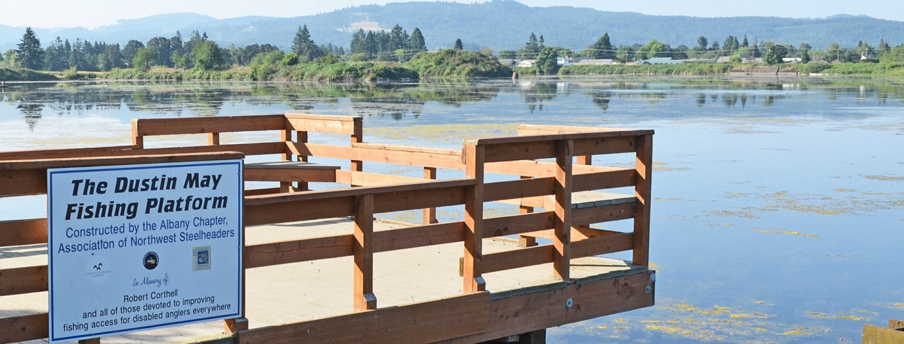
The Health Benefits of Fishing Is No Fish Tale The benefits of fishing as a hobby not only provide a healthy meal but also promote focus and relaxation. And the best part about fishing is that anyone can enjoy it. While remote rivers and open oceans offer prime fishing spots, you can find opportunities even in urban areas. Fishing is affordable and accessible, making it easy to dive into. With countless benefits and few downsides, why wait? Head to your local waters or seek out a guide nearby and give it a try!

Slide 24
Different areas to explore when choosing an accessible fishing spot:
Bridges
River bank
Beach/ shore
Pier casting
Boat side
Just a few P.E.I has to offer:
Scales Pond.
Mooney’s pond and Anderson’s pool. ( Morrell River Management Co-op & Mooney pond Research.)
Victoria Park Charlottetown.
Glenwood Pond.
Bonshaw Trails and #1 highway bridge.
Beaches with sand mat and accessibility. (Cavendish, Stanhope, and Brackely.)
Most government maintained wharfs:
Higgins
Queen St
North point
North Rustico
North River cos-way (Cornwall)

Slide 25
Lets get REEL for a minute. Don’t be a Shellfish fisher. Share, be social, join a group or a community.
FACEBOOK or (FISHBOOK)
Other media options:
PEI Striped Bass Fishing
PEI Sportfishing
Fishing PEI
Disabled Angling SAFE - Suitable Accessible Fishing for Everyone
Ramcat Fishing for Disabled
PEI Fly Fishing
Instagram
Google
Reddit
Trip advisor
Dept of Fisheries and oceans

